Slide 1
Recitation 1: User Stories
January 16, 2018

Slide 2
Welcome!
My name: Zeeshan Lakhani
Email address: zlakhani@cs.cmu.edu
Office hour: Fridays, 11am – 1pm
Location: WEH 5101

Slide 3
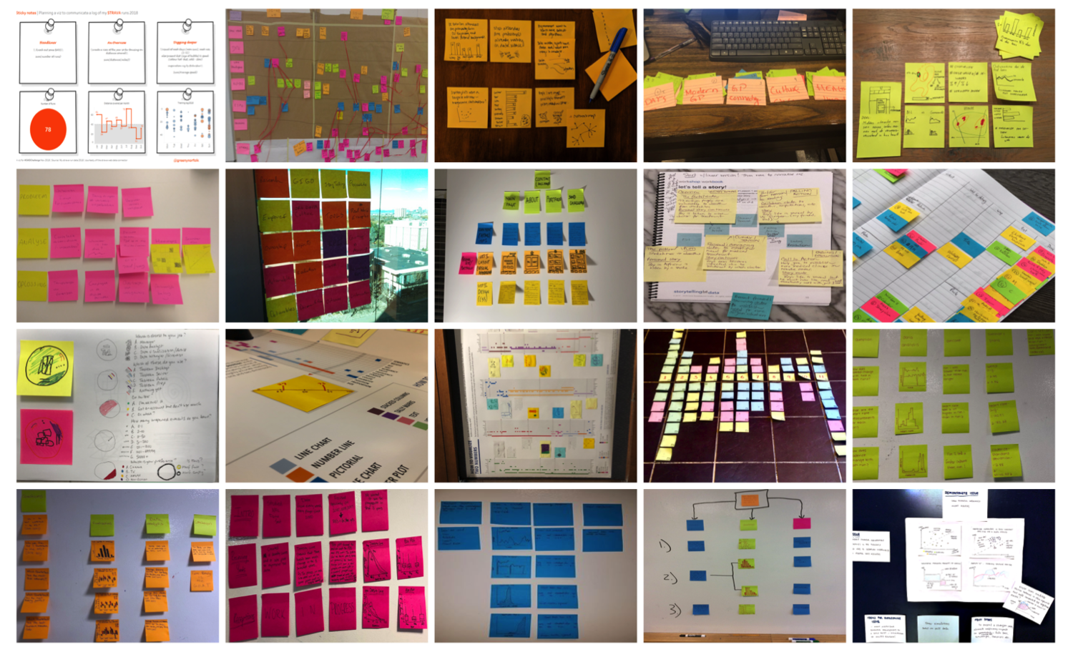

Slide 4
What the Hell are they?
Capture a description of a software feature from an end-user perspective
Are used for planning
Facilitate conversation among users, stakeholders, developers and etc.

Slide 5

Template
As a (type of user),
I want (some feature),
so that (some benefit)

Slide 6
Job Portal Example
As a job seeker,
I want to upload my resume, so that employers consider me for jobs

Slide 7
Epics vs user stories
As a user, I want to sort available jobs by their relevance to my field…
Epic:
Browse jobs
As a user, I want to search for jobs by experience required

Slide 8

Let’s try it

Slide 9
Let’s See it In real life

Slide 10
Let’s try it
Groups of 3-4 people
(As as class) Let’s come up with a small example application
Brainstorm and write 5-10 user stories

Slide 11
What makes a good user story
I
N
V
E
S
T
ndependent
egotiable
aluable
stimable
mall
estable

Slide 12
Rewrite?
Take a look at your user stories and see if they’re consistent with INVEST model
How would you rewrite them?
What are the issues with the INVEST approach?

Slide 13
3 CS Approach
Card: The user stories written on cards by customer/product owner
Conversation: The communication between customer/product owner and developers
Confirmation: Acceptance criteria/test

Slide 14
Homework 1
Via Canvas and Github

